Slide 1

COURSE: DATA SCIENCE tOPIC: Statistics INSTRUCTOR: REEMA MEMON

Slide 2
WHAT IS DISPERSION?
Dispersion in statistics is a way of describing how spread out a set of data is. When a data set has a large value, the values in the set are widely scattered; when it is small the items in the set are tightly clustered.
Very basically, this set of data has a small value of dispersion:
1, 2, 2, 3, 3, 4
This set has a wider one:
0, 1, 20, 30, 40, 100

Slide 3
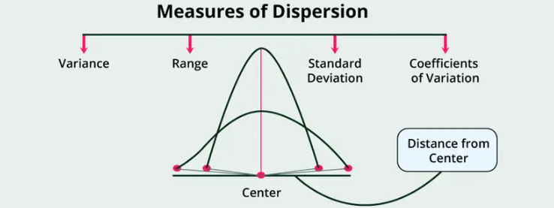
Dispersion of data in Statistics helps one to easily understand the dataset by classifying them into their own specific dispersion criteria like variance, standard deviation and ranging.

Slide 4
MEASURE OF DISPERSION EXAMPLE:
Let’s say you were asked to compare measures of dispersion for two data sets. Data set A has the items 97,98,99,100,101,102,103 and data set B has items 70,80,90,100,110,120,130. By looking at the data sets you can probably tell that the means and medians are the same (100) which technically are called “measures of central tendency” in statistics.
However, the range (which gives you an idea of how spread out the entire set of data is) is much larger for data set B (60) when compared to data set A (6). In fact, nearly all measures of dispersion would be ten times greater for data set B, which makes sense as the range is ten times larger.

Slide 5
WHAT IS VARIANCE?
Variance is a statistical measure that quantifies the spread or dispersion of a set of data points around the mean. It provides a measure of how much the individual data points differ from the average value.
Mathematically, the variance is calculated by taking the average of the squared differences between each data point and the mean. The formula for variance is:
Variance = (1/n) * Σ(xi - μ)²
Where:
n is the number of data points in the set.
xi represents each individual data point.
μ (mu) is the mean of the data set.
Σ denotes the summation symbol, indicating that you sum up the squared differences for each data point.

Slide 6
The squared differences are used to eliminate the cancellation effect that occurs when some differences are positive and others are negative. By squaring the differences, all the values become positive, allowing for a meaningful measure of dispersion.
The variance is always a non-negative value. A larger variance indicates a greater spread of the data points from the mean, while a smaller variance suggests that the data points are closer to the mean.

Slide 7
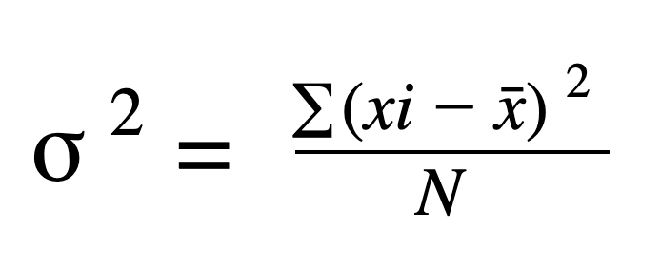
VARIANCE FORMULA:
Find the mean and variance for the following data: 6, 7,10, 12, 13, 4, 8, 12.
Mean = Sum of observations / Total number of observations.
Mean = (6+7+10+12+13+4+8+12)/8
Mean = 72/8
Mean = 9.

Slide 8
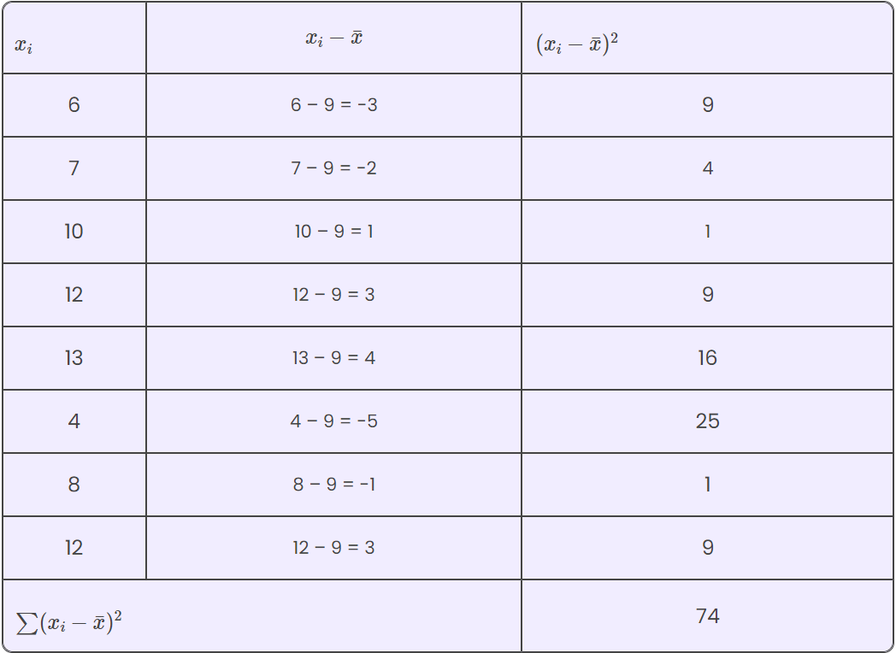

Slide 9
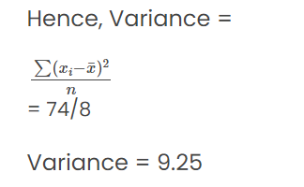

Slide 10
QUESTIONS:
Find the variance of the following scores on an exam: 92, 95, 85, 80, 75, 50.
Find the variance of the highest temperatures recorded in eight specific states. 34,15,52,14,25,33,29,40.
A company collects data on the number of hours employees spend on a particular task per week. The recorded values for 12 employees are as follows: 32, 28, 35, 30, 27, 31, 29, 33, 32, 34, 30, 28. Determine the variance of the hours spent on the task.
Find the variance of the following numbers, 1,4,5,22

Slide 11
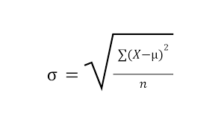
STANDARD DEVIATION:
It is calculated as the square root of the variance.
Standard deviation is a statistical measurement that looks at how far a group of numbers is from the mean.
Formula:

Slide 12
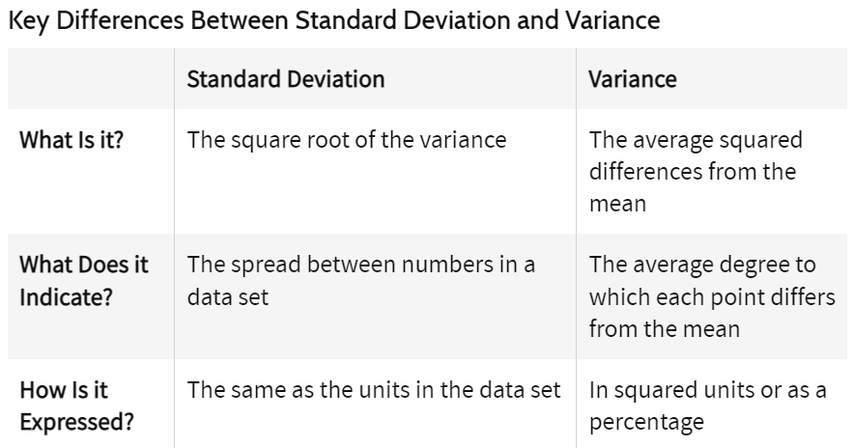

Slide 13
QUESTIONS:
Find the standard deviation of all the 4 questions solved in the previous slides.

Slide 14
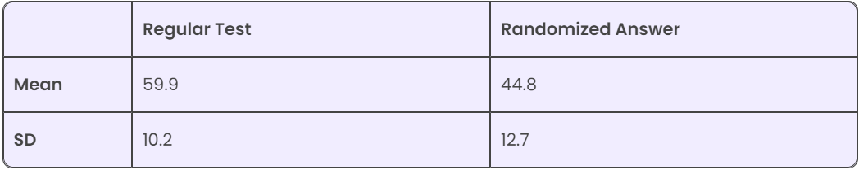
COEFFICIENT OF VARIATION:
The coefficient of variation (CV) is used when comparing the variability of different datasets that may have different scales or units of measurement.
For example, we have two datasets with different means and standard deviations, like in the figure below. Then how to compare them?

Slide 15
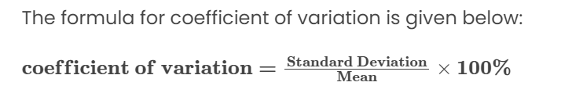
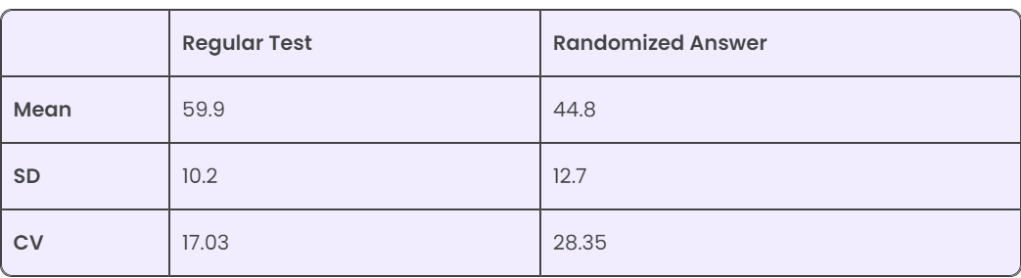
Trying to compare the two test results is challenging. Comparing standard deviations doesn’t really work, because the means are also different.

Slide 16
Looking at the standard deviations 10.2 and 12.7, you might think that the tests have similar results. However, when you adjust for the difference in the means, the results have more significance.
A higher coefficient of variation indicates greater relative variability or dispersion of the data points around the mean, while a lower coefficient of variation suggests lower relative variability or more consistency in the dataset.

Slide 17
Advantages and Disadvantages of the Co-efficient of Variation (CV)
Advantages:
The coefficient of variation can be useful when comparing data sets with different units or widely different means.
Disadvantages
When the mean value is close to zero, the CV becomes very sensitive to small changes in the mean.

Slide 18
QUESTIONS;
Compare the Coefficient of Variation of Questions 1 and 4 mentioned in previous slides.
Suppose, for one dataset the mean is close to 0, and pick any SD. For the other dataset, the mean could be max 5 and pick any SD. Find the CV.

Slide 19
Applications of Standard Deviation and Variance in AI/DS:
Anomaly Detection: SD and variance help identify unusual or abnormal patterns in data. If a data point deviates significantly from the mean of the data, it can be considered an anomaly. By looking at the spread or variability of the data, measured by SD or variance, data scientists can set thresholds to flag data points that deviate too much and investigate them further to understand if they are anomalies.
Feature Selection: In machine learning, data scientists analyze different features and characteristics of the data to build models. SD and variance can be used to decide which features to include in the model. Features with low variance or little variation across the data may not provide much useful information for predicting outcomes. So, data scientists may choose to exclude such features to simplify the model or improve its performance.

Slide 20
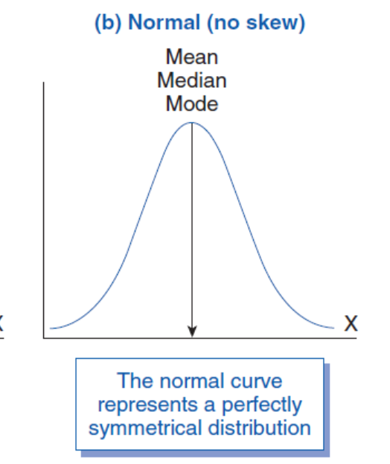
SKEWNESS:
In statistics, skewness is a degree of asymmetry observed in a probability distribution that deviates from the symmetrical normal distribution (bell curve) in a given set of data.
Skewness is zero in normal distributions.

Slide 21
When data is symmetrically distributed, the left-hand side, and right-hand side, contain the same number of observations. (If the dataset has 90 values, then the left-hand side has 45 observations, and the right-hand side has 45 observations.). But, what if not symmetrical distributed? That data is called asymmetrical data, and that time skewness comes into the picture.
Types of Skewness
Positive Skewed or Right-Skewed (Positive Skewness)
Negative Skewed or Left-Skewed (Negative Skewness)

Slide 22
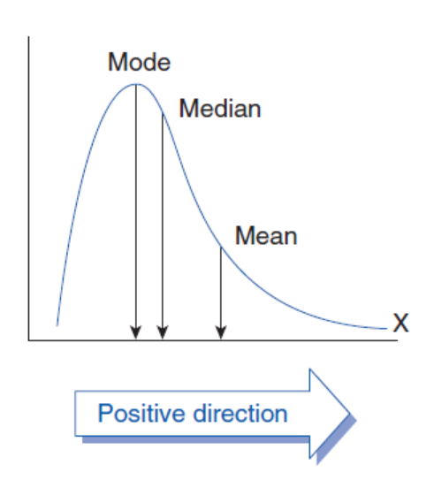
A positively skewed or right-skewed distribution has a long right tail. It is a sort of distribution where the measures are dispersing, unlike symmetrically distributed data where all measures of the central tendency (mean, median, and mode) equal each other. This makes Positively Skewed Distribution a type of distribution where the mean, median, and mode of the distribution are positive rather than negative or zero.

Slide 23
In positively skewed, the mean of the data is greater than the median (a large number of data-pushed on the right-hand side). In other words, the results are bent towards the lower side. The mean will be more than the median.
A negatively skewed or left-skewed distribution has a long left tail; it is the complete opposite of a positively skewed distribution. In statistics, negatively skewed distribution refers to the distribution model where more values are plotted on the right side of the graph, and the tail of the distribution is spreading on the left side.
In negatively skewed, the mean of the data is less than the median (a large number of data-pushed on the left-hand side). Negatively Skewed Distribution is a type of distribution where the mean, median, and mode of the distribution are negative rather than positive or zero.

Slide 24
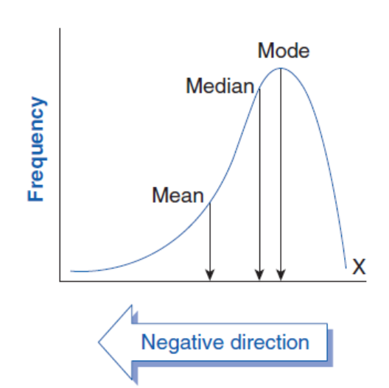

Slide 25

Skewness can be calculated using various methods, whereas the most commonly used method is Pearson’s coefficient.
Pearson’s first coefficient of skewness To calculate skewness values, subtract a mode from a mean, and then divide the difference by standard deviation.

Slide 26
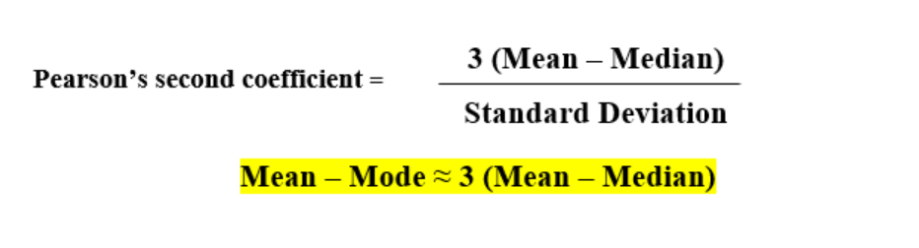
Pearson’s first coefficient of skewness is helping if the data present high mode. But, if the data have low mode or various modes, Pearson’s first coefficient is not preferred, and Pearson’s second coefficient may be superior, as it does not rely on the mode.
Pearson’s second coefficient of skewness:

Slide 27
Rule of thumb :
If the skewness is between -0.5 & 0.5, the data are nearly symmetrical.
If the skewness is between -1 & -0.5 (negative skewed) or between 0.5 & 1(positive skewed), the data are slightly skewed.
If the skewness is lower than -1 (negative skewed) or greater than 1 (positive skewed), the data are extremely skewed.

Slide 28
Example problem: Use Pearson’s Coefficient #1 and #2 to find the skewness for data with the following characteristics:
Mean = 70.5.
Median = 80.
Mode = 85.
Standard deviation = 19.33.
Pearson’s Coefficient of Skewness #1 (Mode): Step 1: Subtract the mode from the mean: 70.5 – 85 = -14.5. Step 2: Divide by the standard deviation: -14.5 / 19.33 = -0.75.
Pearson’s Coefficient of Skewness #2 (Median): Step 1: Subtract the median from the mean: 70.5 – 80 = -9.5. Step 2: Multiply Step 1 by 3: -9.5(3) = -28.5 Step 2: Divide by the standard deviation: -28.5 / 19.33 = -1.47.

Slide 29
Pearson’s first coefficient of skewness uses the mode. Therefore, if the mode is made up of too few pieces of data it won’t be a stable measure of central tendency. For example, the mode in both these sets of data is 9: 1 2 3 4 5 6 7 8 9 9. 1 2 3 4 5 6 7 8 9 9 9 9 9 9 9 9 9 9 9 9 10 12 12 13. In the first set of data, the mode only appears twice. This isn’t a good measure so you would be cautioned not to use Pearson’s first coefficient of skewness. The second set of data has a more stable set (the mode appears 12 times). Therefore, Pearson’s second coefficient of skewness will likely give you a reasonable result.

Slide 30
KURTOSIS:
Kurtosis is a statistical measure that describes the shape of a probability distribution, particularly the presence of outliers or extreme values. It quantifies the degree of peak or flatness of a distribution relative to a normal distribution.
There are three types of kurtosis:
Mesokurtic
Leptokurtic
Platykurtic

Slide 31
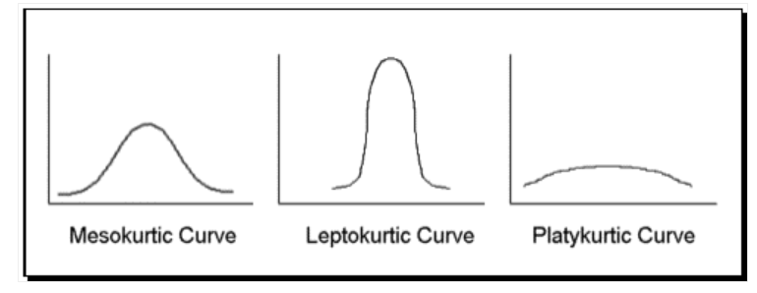

Slide 32
Mesokurtic: A distribution with zero kurtosis is called mesokurtic. It indicates that the distribution has a similar shape to a normal distribution, with neither unusually heavy tails nor an extremely peaked central region.
Leptokurtic: A distribution with positive kurtosis is called leptokurtic. It indicates that the distribution has heavier tails and a more peaked central region compared to a normal distribution. In a leptokurtic distribution, the extreme values occur more frequently, resulting in a higher concentration of data points around the mean and fatter tails.
Example: -5, 2, -7, 9, -8, 6, -4, 10

Slide 33
Platykurtic: A distribution with negative kurtosis is called platykurtic. It has a lower tail and stretched around center tails means most data points are present in high proximity to the mean. A platykurtic distribution is flatter (less peaked) when compared with the normal distribution.
Consider a dataset representing the scores of students on a very easy exam: 90, 92, 88, 85, 89, 91, 87, 86
In this dataset, the scores are tightly clustered around the mean, with a relatively smaller range of values. There are no extreme values or outliers present. The distribution is relatively flat indicating a platykurtic distribution.

Slide 34
The standard deviation and the mean together can tell you where most of the values in your frequency distribution lie if they follow a normal distribution.
The empirical rule, or the 68-95-99.7 rule, tells you where your values lie:
Around 68% of scores are within 1 standard deviation of the mean.
Around 95% of scores are within 2 standard deviations of the mean.
Around 99.7% of scores are within 3 standard deviations of the mean.
You administer a test to a group of students. The data follows a normal distribution with a mean score of 50 and a standard deviation of 10.
Following the empirical rule:
Around 68% of scores are between 40 and 60.
Around 95% of scores are between 30 and 70.
Around 99.7% of scores are between 20 and 80.

Slide 35
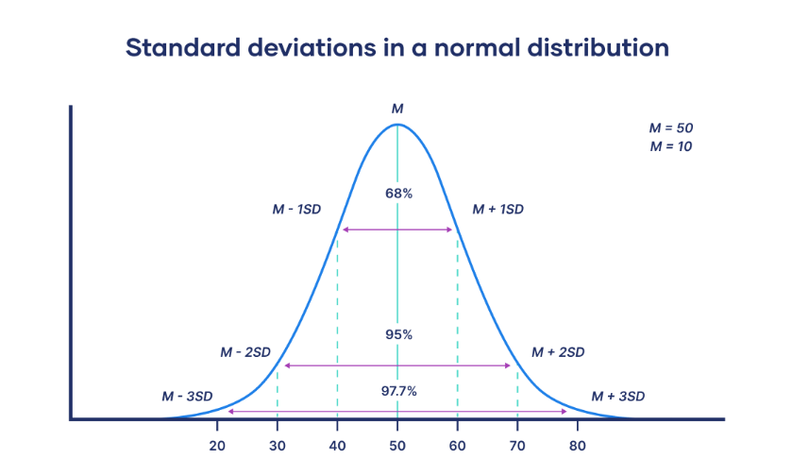

Slide 36
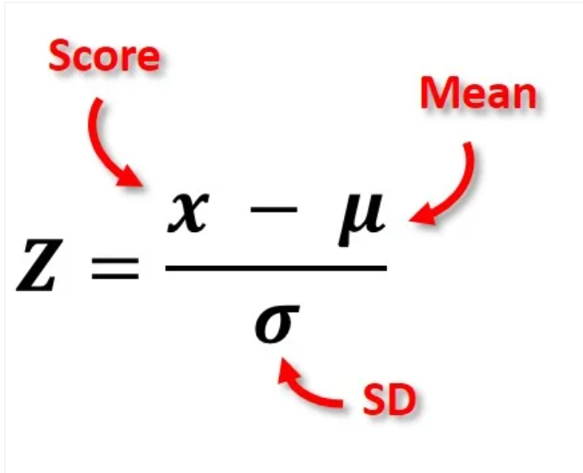
Z-SCORE:
A z-score measure exactly how many standard deviations above or below the mean a data point is.
It is also called the standard score.
A positive z-score says the data point is above average.
A negative z-score says the data point is below average.
A z-score close to 0 says the data point is close to average

Slide 37
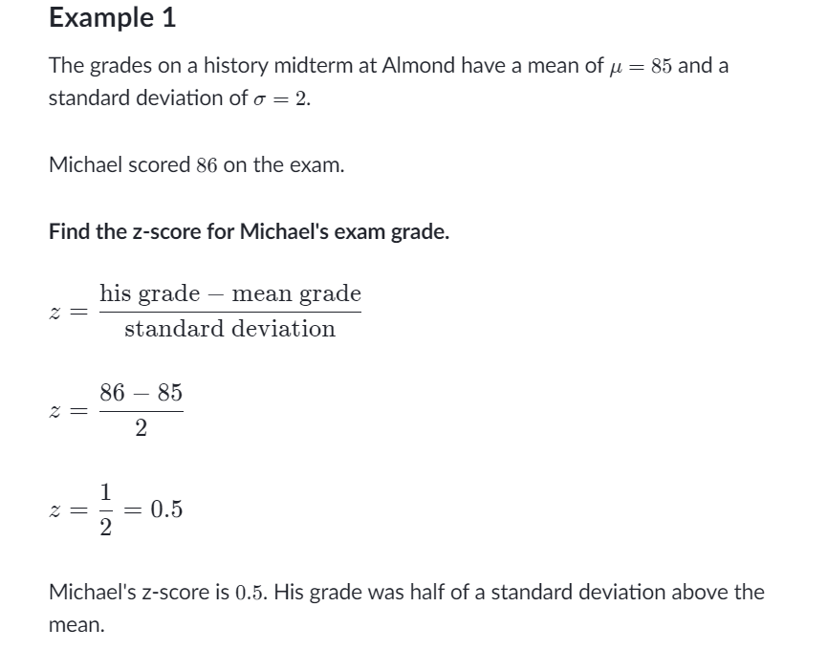

Slide 38
QUESTIONS:
The grades on a Maths exam have a mean of 82 and a S.D of 4. Ali scored 74 on the exam. Find the z-score for Ali’s exam grade.
Scores on a psychological well-being scale range from 1 to 10, with an average score of 6 and a standard deviation of 2. What is the z-score for a person who scored 4?
On a measure of anxiety, a group of participants show a mean score of 35 with a standard deviation of 5. What is the z-score corresponding to a score of 30?
In a study on sleep, participants report an average of 7 hours of sleep per night, with a standard deviation of 1 hour. What is the z-score for a person reporting 5 hours of sleep?

Slide 39
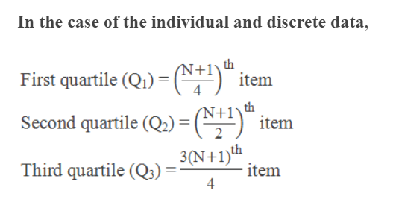
QUARTILES:
Quartiles are the values that divide a list of numbers into quarters.
Put the list of numbers in order.
Then cut the list into four equal parts.

Slide 40
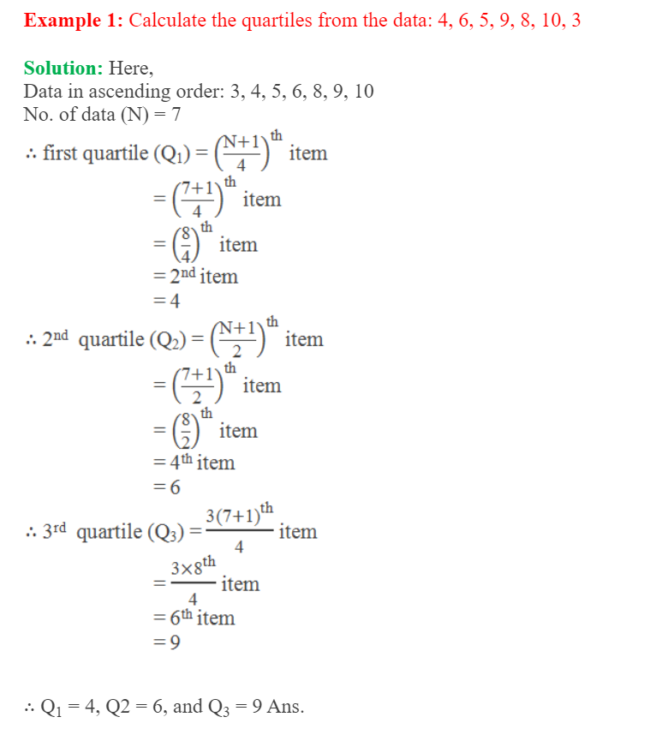

Slide 41
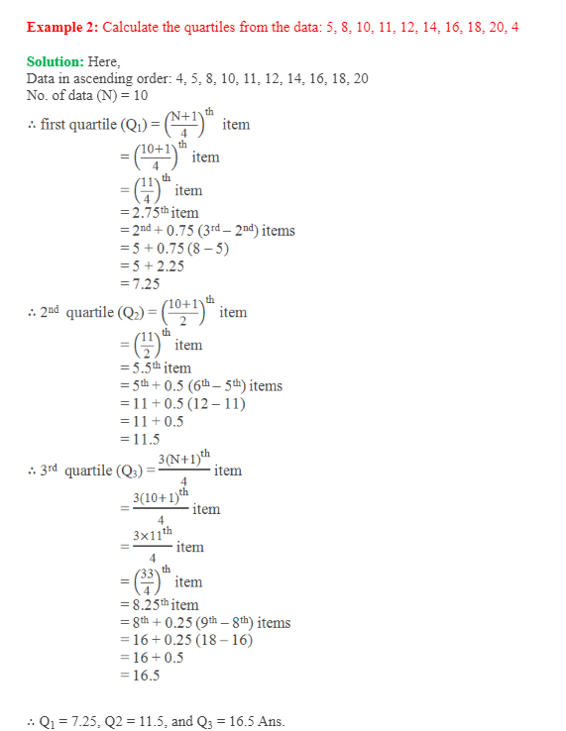

Slide 42
QUESTIONS:
1. What are the quartiles for the following set of numbers?
8, 11, 20, 10, 2, 17, 15, 5, 16, 15, 25, 6
2. What are the quartiles for the following set of numbers?
13, 18, 6, 20, 25, 11, 9, 18, 3, 30, 16, 9, 8, 23, 26, 17

Slide 43
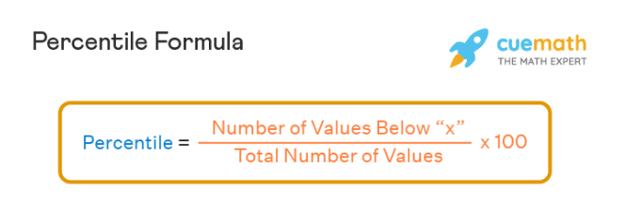
PERCENTILE:
The percentile of data value from a set of data values is a statistical measure that gives the percentage of data values that fall below a given data value. For example, in a group of 20 children, Ben is the 4th tallest and 80% of the children are shorter than him. Hence, it means that Ben is at the 80th percentile.

Slide 44
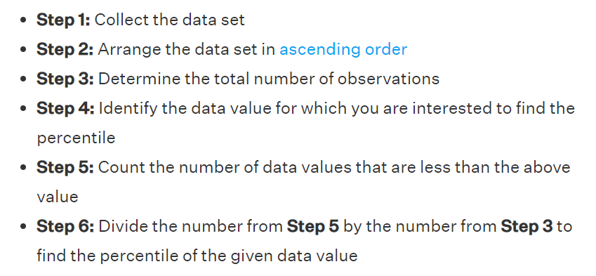
Steps to calculate Percentile:

Slide 45
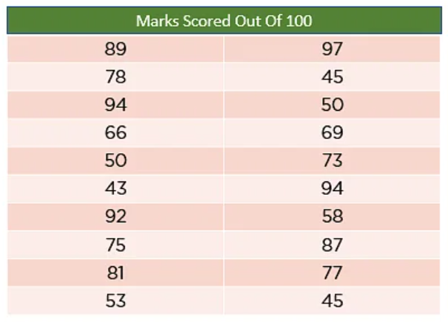
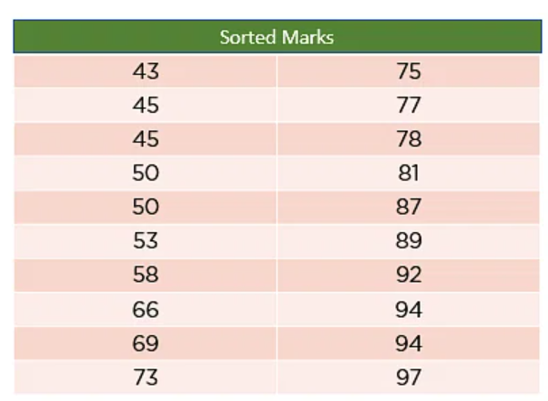
Suppose you want to find the percentile mark of 78 marks in the data set.

Slide 46
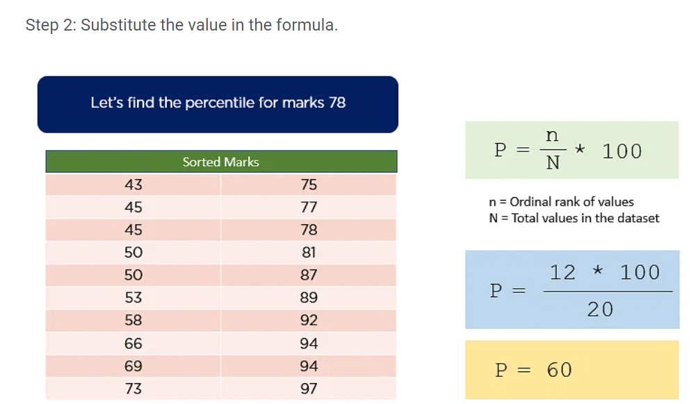

Slide 47
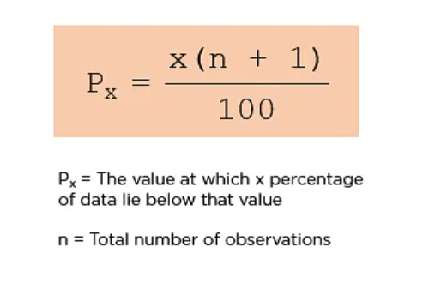
If percentile is given:
Formula:
Imagine you have the marks of 20 students. Now, try to calculate the 90th percentile.

Slide 49
